Slide 1
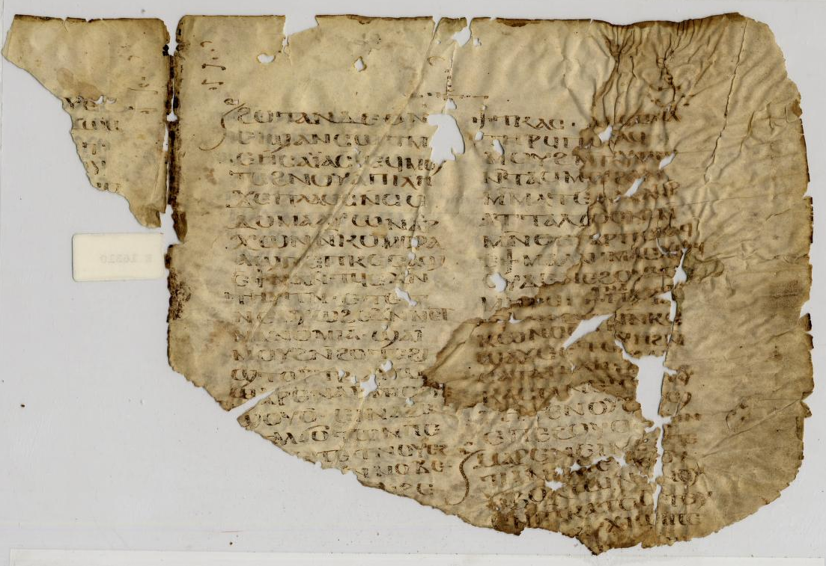
The Odyssey
An ancient adventure story

Slide 2
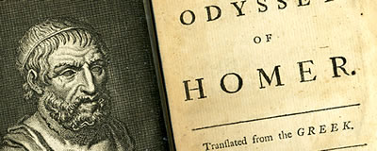
Homer
We don’t know if Homer was a real person, but he is named as the author of two epic adventure stories written in poem form:
The Illiad, about the Trojan War,
and The Odyssey, about Odysseus and his troubles getting back home after fighting in the Trojan War.

Slide 3
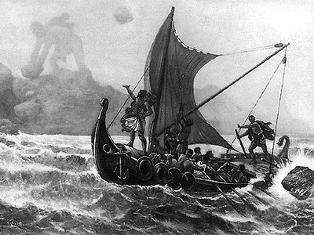
The Odyssey
The Odyssey is a good template for almost any adventure story ever.
The central motive for the main characters is to return home and reclaim what is rightfully theirs
Because it is a sea voyage, any number of dangers can be put in their path, as they try to get home.
(a story with a similar “sea voyage” structure is Jason and the Argonauts and the Quest for the Golden Fleece)

Slide 4
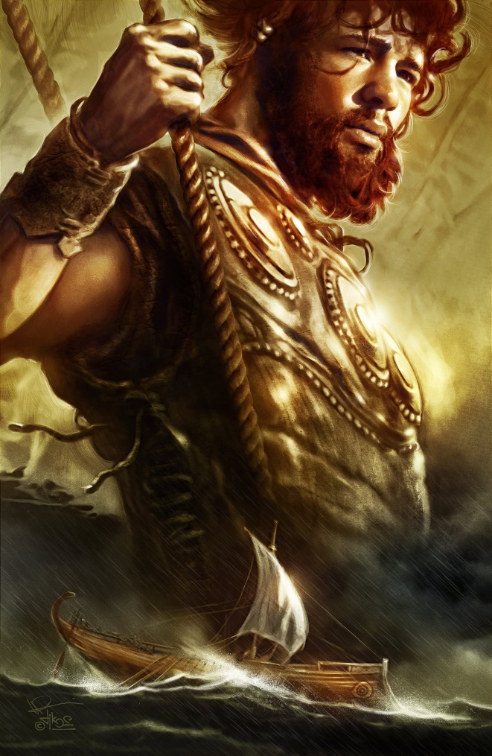
Free at Last
Odysseus (Ulysses in Latin) has been imprisoned on an island for seven years, but now is free to try to return home

Slide 5
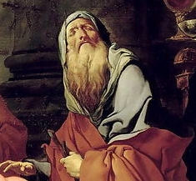
Tiresias
Odysseus and his crew hear mysterious prophecies from Tiresias, the blind prophet.

Slide 6
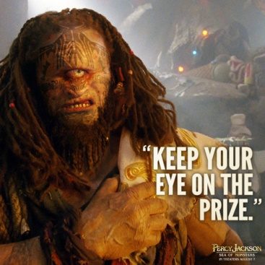
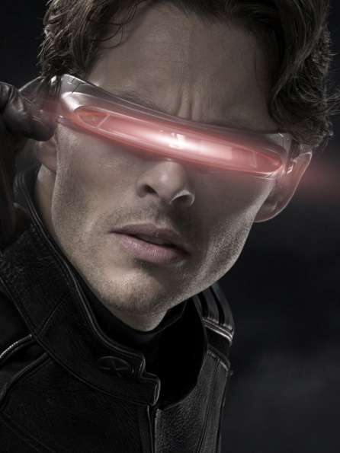
Polyphemus
Odysseus and his crew face a Cyclops, a one-eyed giant shepherd who wants to eat them.
Odysseus blinds the Cyclops Polyphemus by poking it in its single eye with a burning stick, and when asked who he is, Odysseus says his name is “Nobody.”
Then later, when Polyphemus is asked who blinded him, he says “Nobody!”

Slide 7
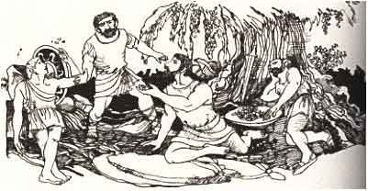
The Island of the Lotus Eaters
Odysseus and his crew come to an island which is inhabited by lotus eaters. These drug addicts laze around, eating lotus fruit and being high all the time.
Odysseus has to get his men to leave that island, before they forget who they are and their mission to get home.

Slide 8
The Sirens
Odysseus and his crew face sirens, seductive sea creatures whose sexy song magically lures lonely sailors to their death beneath the water.
Odysseus has his crew plug their ears with wax so they won’t be lured to their deaths.
Odysseus himself wants to hear the siren’s song, so he has his men tie him to the mast as they sail past.

Slide 9
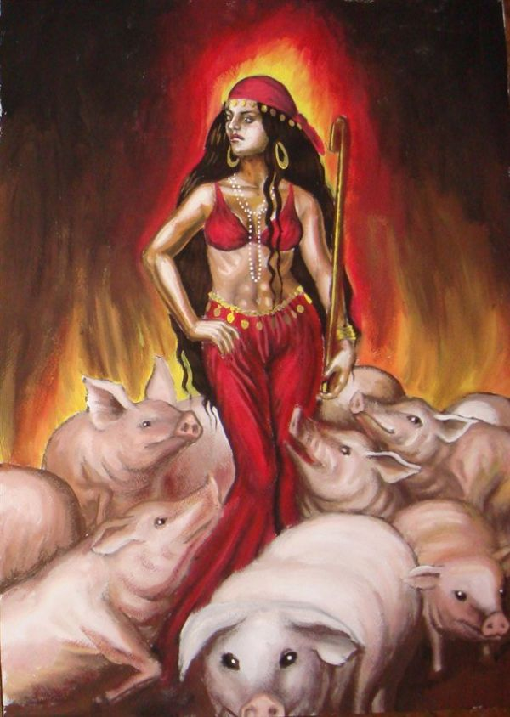
Circe
Odysseus and his crew also meet Circe, a seductive sorceress, who feeds them wine and cheese, and then transforms Odysseus’ men into pigs and other animals.
Odysseus, immune to her magic thanks to a potion, charms Circe into turning his men back into their human forms.

Slide 10
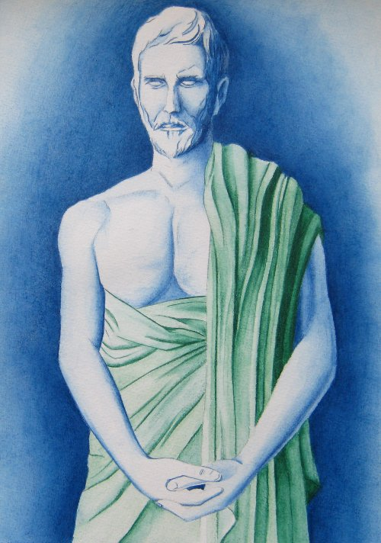
The Ghost of Elpenor
Odysseus and his crew encounter the spirit of crewmember Elpenor, who had gotten drunk and fallen from a roof to his death.
He asks them to bury him properly, which they do.

Slide 11
Drowned
All of Odysseus’ crew are drowned by a monstrous whirlpool named Charybdis, but Odysseus clings to a tree and survives.

Slide 12
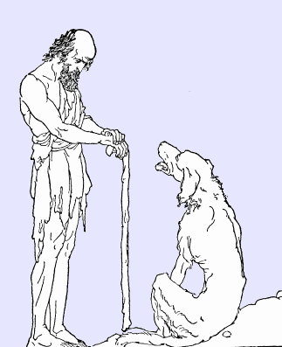
Home in Disguise
Returning him home, Athena disguises Odysseus as a wandering beggar so he can see how things stand in his household.
Odysseus’ dog Argos knows him immediately but no one else does.

Slide 13
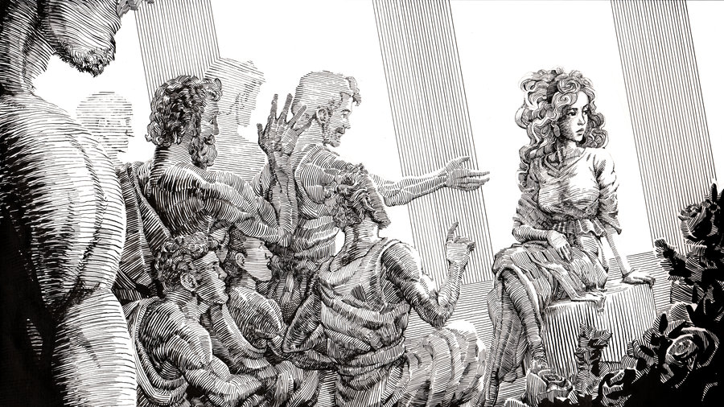
Suitors
Odysseus’ wife Penelope has had to look after Odysseus’ rich estate in his absence and a huge number of suitors are living there and partying with Odysseus’ wealth.
They all want to marry Penelope so they can take full ownership of Odysseus’ riches.

Slide 14
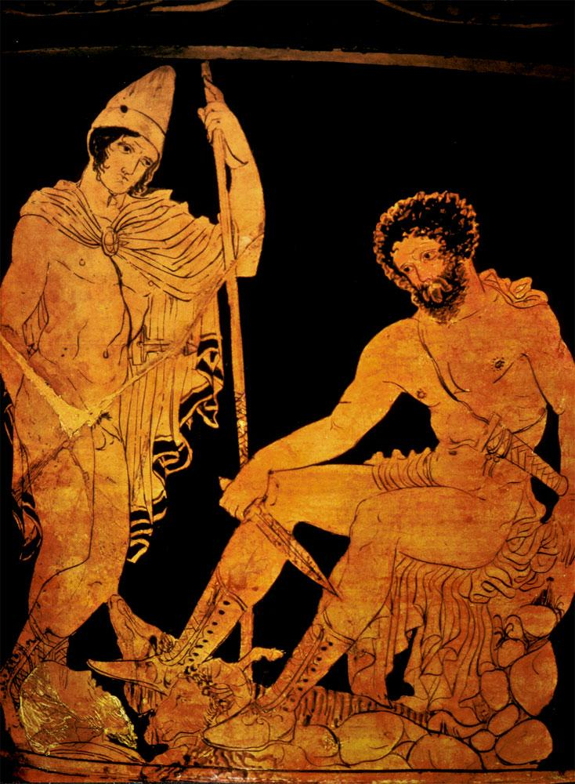
Telemachus
Odysseus meets his son, Telemachus, and they decide the suitors need to be killed.
So they devise a contest only Odysseus can win.

Slide 15
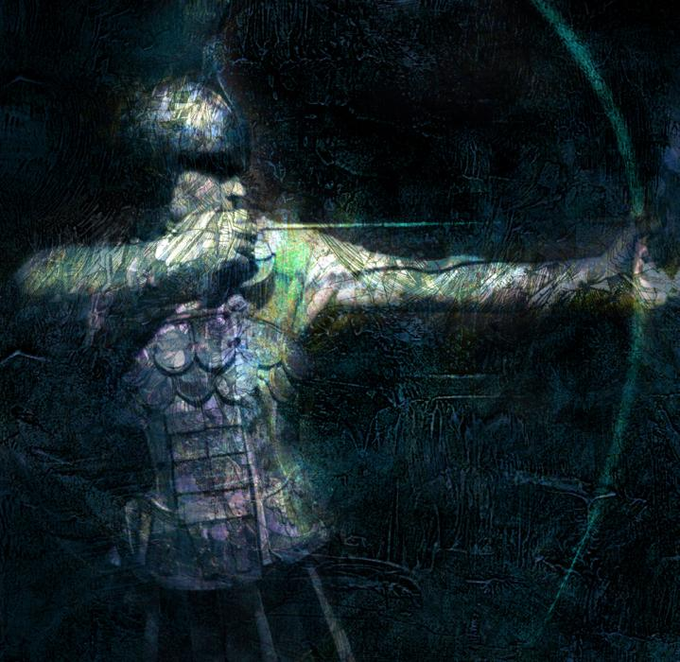
The Contest
Odysseus proves his identity, and his right to be Penelope’s husband, by an archery contest with the suitors.
The contest involves being strong enough to string Odysseus’ heavy bow, and then firing an arrow through the holes in a dozen axe-heads laid end to end.
Only Odysseus can do this, so he wins and executes the suitors.

Slide 16
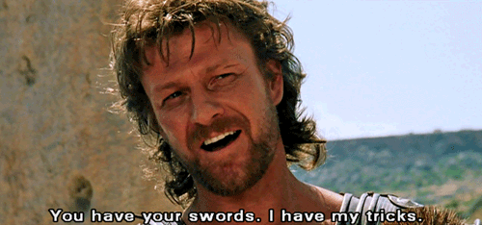
Odysseus as a Character
Odysseus’ name (Ulysses in Latin) means “trouble.”
Odysseus is skilled at getting into, and talking and tricking his way out of, trouble.
Since Homer, many main characters have been like this, in stories.

Slide 17
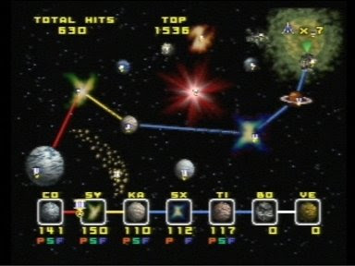
Adventure Stories
Modern adventure stories often follow the same structure as The Odyssey: a crew or group of people need to get home or reclaim what is theirs, and endless obstacles can be put in their path.
Planets, or islands, towns or other locations can get in their way, with:

Slide 18
Desert
A sea of sand instead of water, with small settlements like islands, with adventures in them.

Slide 19
Cold
A sea of ice and snow, with small livable human settlements instead of islands, and adventures there.

Slide 20
Zombies
A sea of the walking dead, with islands of human settlements here and there, and adventures in them.

Slide 21
Seductive Witches
Many modern stories have seductive witches in them.

Slide 22
Pirates
Pirate stories involve the sea, islands and strange creatures and enemies.

